Slide 1
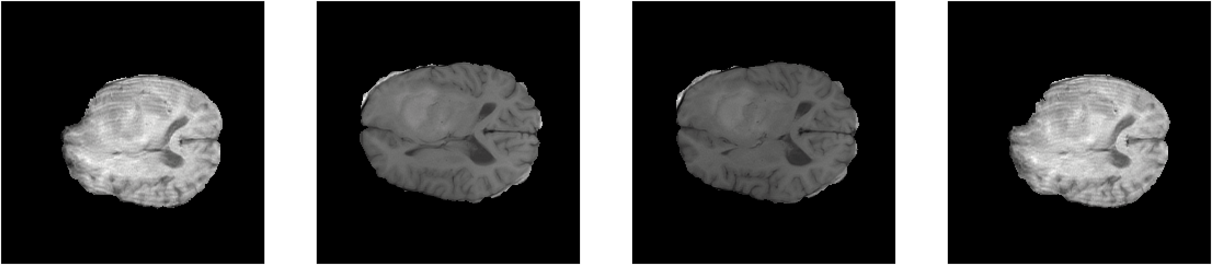
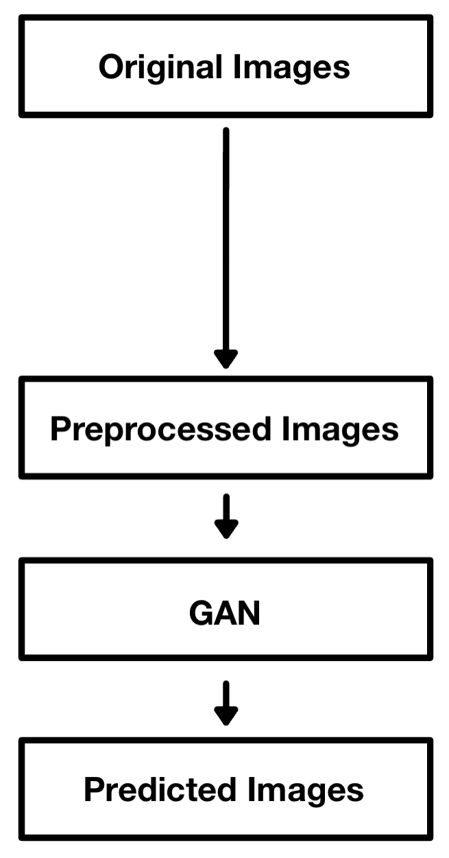

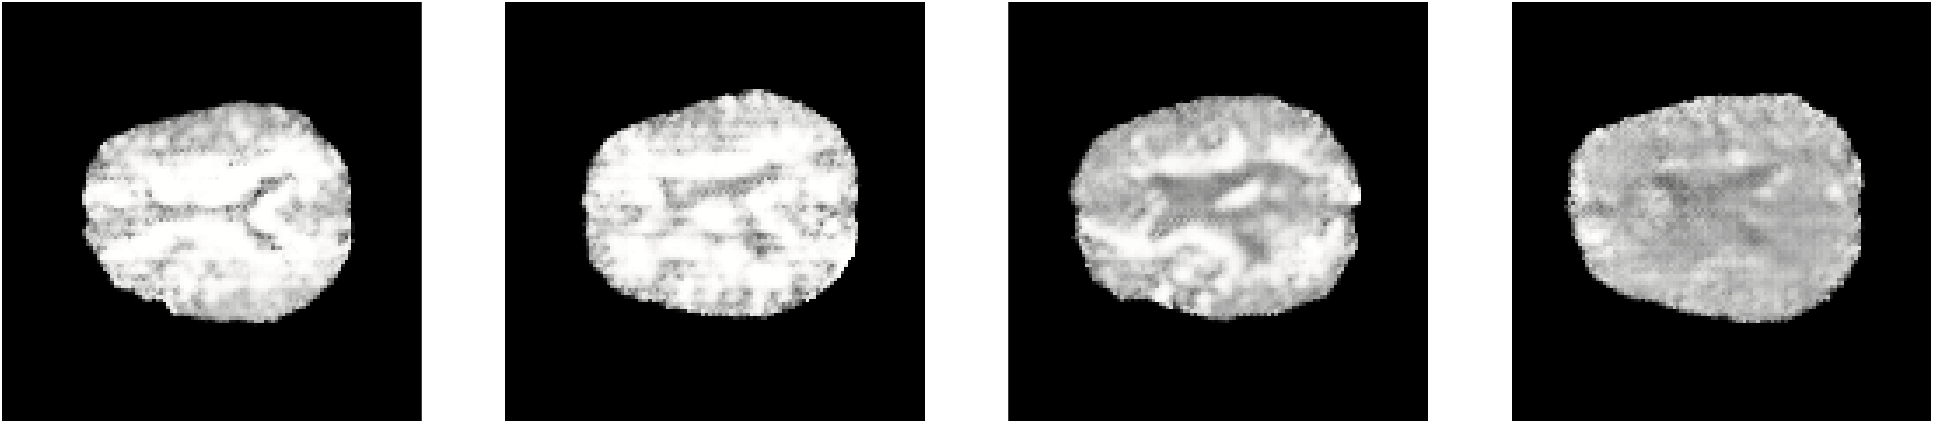
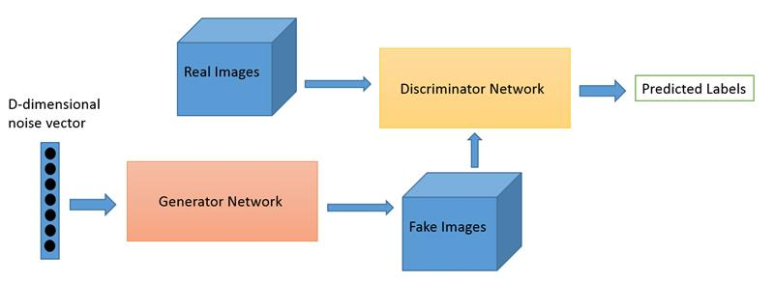
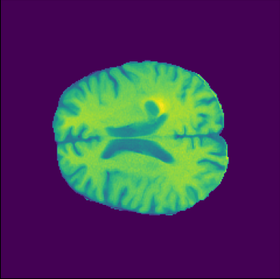
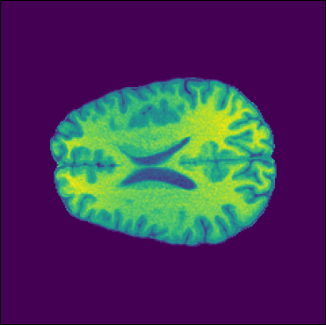
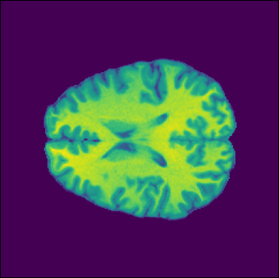
Generating Brain MRI Images using DCGANs
Aidan Birdi, Zijia Lin, Muzammil Farhan, Muyi Su. Supervisor: Emily Muller
Interdisciplinary Research Computing, Imperial College London 2023
INTRODUCTION
What is an MRI?
MRI is a form of medical imaging that uses strong magnetic fields to generate 3-dimensional images. It is often used to image soft tissues such as the brain and muscles. It is generally considered a non-invasive procedure as compared to X-rays and CT scans which employ radiation. In the UK alone, there were 3.793 million MRI scans between Sep 2018 and Sep 2019 [3]. It is estimated that more than 11,000 people are diagnosed with a brain tumour in the UK each year [5].
Limitations with Obtaining MRI Scans
Due to the GDPR, it is difficult to obtain medical images to be used for purposes such as research and training. The GDPR requires any medical images used for research to be acquired with explicit consent, it also requires data to be anonymised for use in research [4]. Medical data is also scarce due to the costs of medical imaging.
Our Solution
Our solution was to generate synthetic MRI images using a GAN model trained by analysing MRI images of different stage glioma tumours. Our goal was to create synthetic MRI scans that would be non-identifiable and could be used for training and research purposes. This would increase the amount of medical data available and would introduce new data in a cost- effective manner in comparison to actually taking scans.
Sections:
MRI uses, what it is, population with brain tumours stat - done
Difficulties of gathering and training with MRI images due to data protection
Our purpose of generating synthetic MRI, briefly what kind of model uses
Fig. 3. Original (top row), pre-processed (middle row), and GAN-predicted (bottom row) images of cross-sectional brain MRI scans.
RESULTS
OBJECTIVES, MATERIALS, AND METHODS
Our project aims to leverage a Deep Convolutional Generative Adversarial Network (DCGAN) to create clinically accurate glioma images across multiple grades. Figure 1 illustrates the rough structure of a typical Generative Adversarial Network (GAN).
CONCLUSIONS AND DISCUSSION
Fig. 1. Illustration of a Generative Adversarial Network, figure retrieved from [1].
To train the DCGAN, we utilized cross-sectional MRI scan images from the University of California San Francisco Preoperative Diffuse Glioma MRI (UCSF-PDGM) database [1]. The UCSF-PDGM database includes 501 cases, which encompass 55 (11%) grade II, 42 (9%) grade III, and 403 (80%) grade IV tumours; in each case, 9 cross sectional MRI scans at about the same height were used to train the DCGAN.
REFERENCES
[1] A Beginner’s Guide to Generative Adversarial Networks (GANs) [Internet]. Pathmind. Available from: https://wiki.pathmind.com/generative-adversarial-network-gan/ [Accessed 19th Mar 2023].
[2] The University of California San Francisco Preoperative Diffuse Glioma MRI (UCSF-PDGM) – The Cancer Imaging Archive (TCIA) Public Access - Cancer Imaging Archive Wiki. Available from: https://wiki.cancerimagingarchive.net/pages/viewpage.action?pageId=119705830/ [Accessed 18th Mar 2023]
[3] Dixon S. Diagnostic Imaging Dataset Statistical Release [Internet]. NHS UK. NHS England and NHS Improvement; 2020 Jan [cited 2023 Mar 19] p. 6. Available from: https://www.england.nhs.uk/statistics/wp-content/uploads/sites/2/2020/01/Provisional-Monthly-Diagnostic-Imaging-Dataset-Statistics-2020-01-23.pdf
[4] European Society of Radiology (ESR). The new EU General Data Protection Regulation: what the radiologist should know. Insights Imaging 8, 295–299 (2017). https://doi.org/10.1007/s13244-017-0552-7
[5] NHS. Brain tumours [Internet]. NHS. 2019. Available from: https://www.nhs.uk/conditions/brain-tumours/
‌
Fig. 2. Cross-sectional brain MRI scans for tumour grade IV (left, case 0004), III (middle, case 0251), and II (right, case 0232), respectively, from the UCSF-PDGM database [2].
In total, 4455 images were used for training the DCGAN. The original images were of 240×240 pixels and were stored in float 64. For the ease of computation using GPUs, we compressed the images to 120×120 pixels in float 32.
We pre-processed the images using a Min-Max Scaler, rescaled logit transform and truncating function to improve the distribution for the DCGAN to replicate. We, however, did lose information by doing this, and this is likely a
ACKNOWLEDGEMENT
We would like to express our sincere gratitude to the invaluable assistance of Ms. Emily Muller for her insightful suggestions and feedback. We are also grateful to University of California San Francisco for providing access to their Glioma MRI database. We would like to express our appreciation to all members of Interdisciplinary Research Computing group at Imperial College London for their constant support and encouragement throughout this research endeavor.

